Slide 1
Graphic File Formats
Week 11 Lecture 1

Slide 2
Graphic File Formats
Standardized ways to organise and store image data
Image files are made up of picture elements called pixels
Pixels form a grid of columns and rows
Each pixel is a number
  Brightness and colour

Slide 3
Image File Sizes
Image file sizes, expressed in bytes, increase with
  the number of pixels in the image,
  the color depth of the pixels.
The more rows and columns, the greater the image resolution and the greater the file size.
High resolution digital cameras record 8 megapixels (MP) images, or more, in truecolor.
Since each of the pixels uses 3 bytes to record true color, the uncompressed image would occupy 24 MB of memory.
About 40 photos on a 1 GB memory card

Slide 4
Image File Sizes
Image compression:
  algorithms to decrease file size.
Faced with large file sizes, both within the camera, and later on disc, image file formats have been developed to address the storage problem.
Two types of image file compression algorithms:
  lossy and
  lossless.

Slide 5
Lossless data compression
Data compression algorithms that allows the exact original data to be reconstructed from the compressed data
Used when it is important that the original and the decompressed data be identical
Lossless compression methods may be categorized according to the type of data they are designed to compress: text, images, and sound
Different kinds of algorithms: one which generates a statistical model for the input data, and another which maps the input data to bit strings using this model

Slide 6
Lossless Data Compression
Statistical modelling algorithms :
  BWT - Burrows-Wheeler transform (block-sorting compression )
  LZW - Lempel-Ziv-Welch, 1984
Encoding algorithms to produce bit sequences are:
  Huffman coding
  Arithmetic coding
Frequently encountered data will produce shorter output

Slide 7
Lossy Data Compression
Compressing data and then decompressing it retrieves data that may well be different from the original, but is "close enough" to be useful in some way.
The advantage of lossy methods over lossless methods is that in some cases a lossy method can produce a much smaller compressed file than any known lossless method, while still meeting the requirements of the application
Most commonly used standard method of lossy compression for photographic images – JPEG (the file format uses the same name as the method)

Slide 8
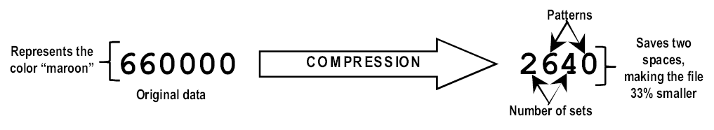
Image File Sizes
Simple Compression
Lossless or lossy compression??

Slide 9
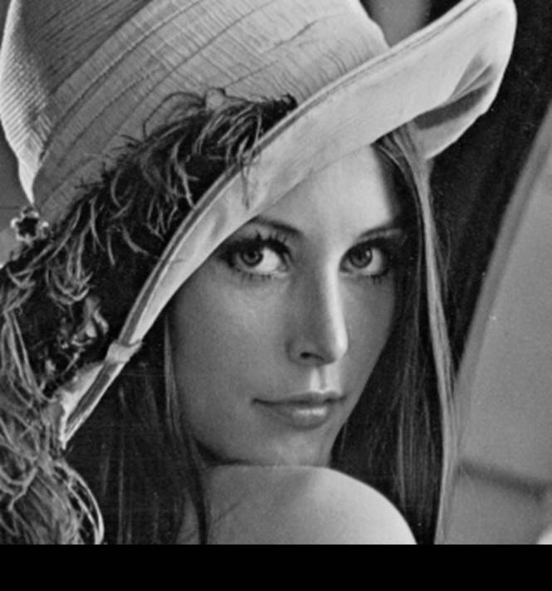




Image Compression

Slide 10
Graphic File Formats
GIF - Graphics Interchange Format
JPEG - Joint Photographic Experts Group Format
TIFF - Tag Image File Format
PNG - Portable Network Graphics format
BMP - Microsoft Windows bitmap format

Slide 11
GIF - Graphics Interchange Format
The GIF format was introduced in 1987 by CompuServe
GIF was the first graphic file type to be displayed by early web browsers, and it remains the most popular format on the Web to this day
GIFs are completely platform-independent
There are technically two types of GIF file: GIF87a and the newer, improved GIF89a. Both are fully supported on most browsers
GIF89a is the same, but also includes transparency and animation capabilities

Slide 12
GIF - Graphics Interchange Format
GIF files are indexed color images that can contain a maximum of 8-bit color information (they can also be saved at lower bit rates). This means they can contain up to 256 colors
it is a "lossless" compression, meaning no image information is lost in the compression process, and the decompressed image is identical to the original
Note that some information may be lost in the conversion process from RGB to indexed color format, but once it is converted, the compression itself is lossless
GIF uses LZW (Lempel-Zev-Welch) compression, which takes advantage of repetition in data streams

Slide 13
LZW compression
RRGBGBGGBRGBBGBRRGBGBGBGBBBRRBGBG
When split up we discover a variety of identical strings: RRG BGB GG BR GB BGB RRG BGB G BGB B BR R BGB G
$_1$_2GG$_3GB$_2$_1$_2G$_2B$_3R$_2G
[$_1=RRG][$_2=BGB][$_3=BR]

Slide 14
LZW compression
or another possibility:
RR GBGB G GBR GB B GBR R GBGB GBGB BB RR B GB G $_1$_2G$_3$_4B$_3R$_2$_2BB$_1B$_4G [$_1=RR][$_2=GBGB][$_3=GBR][$_4=GB]

Slide 15
LZW Compression
...and a last one: RRGBGBG GB R GB B GB RRGBGBG B GB BBRRB GB G

Slide 16
LZW Compression
$_1$_2R$_2B$_2$_1B$_2BBRRB$_2G [$_1=RRGBGBG][$_2=GB]

Slide 17
When to use GIFs
GIF is particularly well suited for any image with areas of flat color, such as
  logos,
  line art,
  icons,
  cartoon-like illustrations, etc.
You will also need to use GIF format if you want a portion of the image to be transparent
GIF is also a good option for adding simple animation to your page without relying on plug-in technology, Java programming, etc
GIFs are not particularly good for photographic images

Slide 18
JPEG - Joint Photographic Experts Group Format
JPEG - one of the most popular graphics formats
JPEG images contain 24-bit RGB color information (color space of millions of colors)
JPEG uses a "lossy" compression scheme
JPEG is able to achieve 10:1 to 20:1 data-compression ratios without visible loss in quality

Slide 19
JPEG
The efficiency of JPEG compression is based on the spatial frequency, or concentration of detail, of the image
Image areas with low frequency (smooth gradients, like a blue sky) are compressed much further than areas with higher frequency (lots of detail)
The compression algorithm samples the image in 8X 8-pixel squares and then translates the relative color and brightness information into mathematical formulas.

Slide 20
JPEG
JPEG uses YCbCr (orYUV) color space
The difference between YCbCr and RGB is that YCbCr represents color as brightness and two color difference signals, while RGB represents color as red, green and blue.
YCbCr signals are created from an original RGB (red, green and blue) source
In YCbCr, the Y is the brightness (luma), Cb is blue minus luma (B-Y) and Cr is red minus luma (R-Y).
Y= 0.299R + 0.587G + 0.114B
U= 0.492(B − Y)= − 0.147R − 0.289G + 0.436B
V= 0.877(R − Y)= 0.615R − 0.515G − 0.100B

Slide 21
JPEG
One advantage to JPEGs is that you can control the degree to which the image is compressed
The higher the quality, the larger the file
The quality of a JPEG image is denoted by its "Q" setting, usually on a scale from 0 to 100
The lower numbers represent lower image quality but better compression rates (and smaller files)
The higher numbers result in better image quality and larger files.

Slide 22
JPEG
Once image quality is lost in JPEG compression, you can never get it back again.
Loss in image quality is also cumulative
You lose a little bit more information each time you decompress and compress an image
Simply opening or displaying a JPEG image does not harm the image in any way.
Saving a JPEG repeatedly during the same editing session (without ever closing the image) will not accumulate a loss in quality

Slide 23
JPEG
Copying and renaming a JPEG will not introduce any loss
If a JPEG image is closed, re-opened, edited and saved again it results in additional image degradation.
It is very important to minimize the number of editing sessions between the initial and final version of a JPEG image.
Always keep a lossless master copy of any image you expect to edit again in the future.

Slide 24
TIFF Tag Image File Format
TIFF, Tag(ged) Image File Format, was designed by the companies Aldus and Microsoft in the 1980s to store pixel image data.
The specification was owned by Aldus, which in turn merged with Adobe Systems, Incorporated.
Consequently, Adobe Systems now holds the Copyright for the TIFF specification.
TIFF was originally created as an attempt to get desktop scanner vendors of the mid-1980's to agree on a common scanned image file format, rather than have each company promulgate its own proprietary format

Slide 25
TIFF
TIFF is a flexible and adaptable file format. TIFF was designed to be independent of the hardware platform and the operating system on which it executes.
TIFF makes very few demands upon its operating environment. TIFF should (and does) perform equally well in both the "IBM PC" and Apple Macintosh's environments -- and UNIX.
It can handle multiple images and data in a single file through the inclusion of "tags" in the file header.

Slide 26
TIFF
In practice, TIFF is used almost exclusively as a lossless image storage format that uses no compression at all.
Most graphics programs that use TIFF do not use compression.
Consequently, file sizes are quite big.
Sometimes a lossless compression algorithm called LZW is used, but it is not universally supported.

Slide 27
PNG - Portable Network Graphics format
PNG for short -- pronounced "ping"
PNG was developed in January and February 1995 as an effort to find a non-proprietary alternative to GIF
Reason - Unisys threatened to enforce its patent on GIF
The PNG format became an official W3C Recommendation in October of 1996
PNGs are still not universally supported
  Even the browsers that do support it, don't fully support all features
  Graphic tools don’t compress PNGs very well

Slide 28
PNG
8-bit palette support (like GIF), support of 16-bit grayscale, and up to 48-bit truecolor (RGB) support
A lossless compression scheme and better compression than GIF for indexed color (palette) images
Several methods for checking file integrity and corruption
Nonpatented compression free from licensing restrictions (open source)

Slide 29
PNG
Although PNG does support 24-bit color and higher, its lossless compression scheme nearly always results in larger files than JPEG's lossy compression when applied to the same image.
Photographic and continuous tone images are still best saved as JPEGs
PNGs are recommended for the type of image that would typically be saved as a GIF (graphics with areas of flat color or sharp edges)

Slide 30
PNG
The most notable aspect of PNG compression is that it is "lossless“, meaning no information is lost in the compression process.
A decompressed PNG image is identical to the original.
Like GIFs, PNG's compression works on rows of pixels, taking advantage of repetition in bytes of information
PNG's compression engine typically compresses images 5-25% better than GIF (and up to 39% better under optimal conditions).

Slide 31
Bitmap format
Bitmap format is:
  Generic term for file formats for raster graphics images
  images are stored and displayed as a set of colored points (pixels) in a rectangular grid.
Vector graphics - the representation of a digital image as points, lines and other geometric entities
JPEG, GIF, TIFF, PNG – bitmap formats

Slide 32
Bitmap
Specific term for Windows bitmap (BMP) file format
BMP files are an historic (but still commonly used) file format for the Windows operating system
BMP images can range from black and white (1 byte per pixel) up to 24 bit colour (16.7 million colours).
While the images can be compressed, this is rarely used in practice (usually not compressed)
Format is well-documented and free of patents

Slide 33
Experiment
Take a large image and save in different formats
Note file sizes and image quality

Slide 34
Comparisons
JPEG | the smallest file size; "lossy" compression; 24-bit full colour images; for photographs
GIF | the smallest file size after JPEG; "lossless" compression; 8 bits of colour; for illustrations
TIFF | much larger file size than JPEG or GIF; both 8bit and 24bit colours
PNG | supports higher "lossless" compression rates; the newest of all the graphic formats; 24-bit images;
BMP | without compression; MS-Windows standard; 24-bit images

